Slide 1
Using the Life Cycle Approach for a Rapid HIV-HRH Assessment in Indonesia
Wanda Jaskiewicz
17 November 2018

Slide 2
Assessment Objectives
Assess the HRH-related barriers at the policy and site levels that may be hindering HIV service delivery
Gather evidence to recommend policy and site level interventions to improve HIV service delivery
HRH optimization to achieve Fast-Track targets
Longer-term sustainability planning and HIV mainstreaming
Consideration of differentiated service delivery (DSD) models

Slide 3
Methods

Slide 5
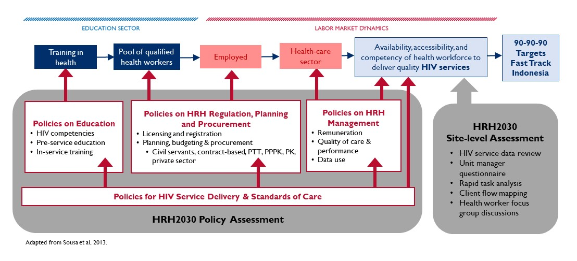
HRH2030 Policy and Site-level Assessment Approach in Indonesia

Slide 6
Site-level tools
Availability
Unit manager questionnaire
Competency
(self-reported)
Rapid task analysis
Accessibility
Client flow mapping
Challenge identification
Health worker focus group discussion

Slide 7
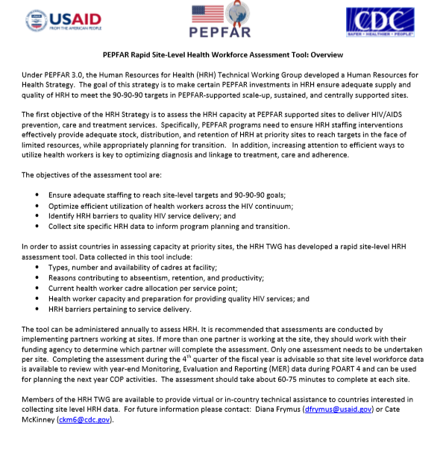
Unit manager questionnaire
Semi-structured interview
HRH Availability
Types, number and availability of cadres at facility
Current health worker allocation per HIV service point
Health worker capacity and preparation for providing quality HIV services
Manager perspectives on
Reasons contributing to absenteeism, retention, and productivity
HRH barriers pertaining to service delivery
Adapted from the PEPFAR Rapid Site-level Health Workforce Assessment Tool
https://www.hrh2030program.org/pepfar_tool/

Slide 8
Rapid Task Analysis (1)
Service Areas
1: Examination of HIV, STI and hepatitis
2: ART Enrollment
3: ART Initiation
4: Adherence Counselling
5: Clinical Examination & Consultation
6: Recording and Reporting
7: Health Education
8: Integrated TB-HIV Services
9: Mobile Testing
10: PMTCT
11: Harm reduction
Health Worker Types
Doctor
Nurse
Lab Technician
Recording & reporting officer
Pharmacy
Midwife
Cadre/community counselor
“Core team” for site activation
Adapted from HRH2030 Rapid Task Analysis Questionnaire
https://www.hrh2030program.org/wp-content/uploads/2018/06/Rapid-Task-Analysis-Tool.pdf

Slide 9
Rapid Task Analysis (2)
In your opinion, to what extent is your knowledge about this task?
Not acquired the basic knowledge
Only the basic knowledge
Necessary knowledge to perform the task
Advanced knowledge
In your opinion, how confident are you in performing the task?
Need more opportunity to apply knowledge
Can apply knowledge but still need help
Confident performing task, but not to teach others
Confident performing task and teaching to others
Is this task assigned to you?
No
Yes
Have you been trained for this task?
No
Yes
How often do you perform this task?
Never
Seldom
A few times a month
A few times a week
Almost every day
Informal, on-the-job training
Clinical mentoring
Formal in-service training
Pre-service training

Slide 10
Client flow mapping
For ART refill patients with undetectable viral load
Participatory observation
Where do they go?
How long does it take?
With which health workers do they interact during the visit?
Where are the service delivery bottlenecks, if any?
For reasons of ethics and confidentiality, CSCs were trained to use tablets to conduct client flow mapping

Slide 11
Health worker Focus Group Discussion (FGD)
Client and health worker flow mapping from HW perspective
Who is involved at each service area?
What are challenges at each service area?
Root cause analysis by HRH category type:
Health worker competency gaps
Low engagement
Poor allocation of staff or tasks
Inefficient work processes
Other health systems issues
Adapted from HRH2030 Optimizing Health Worker Performance and Productivity to Achieve the 95-95-95 Targets
https://www.hrh2030program.org/prodperftoolkit/

Slide 12
Results

Slide 13
Summary results of 8 Puskesmas Kecamatan in Jakarta, 2018
All health workers across all tasks
PKM | HIV Service Volume | Core team | Task knowledge | Confidence to perform tasks | % Training
 | New positives Enrolled in ART Currently on ART | + = - | Advanced Sufficient Basic None | Confident, capable to mentor Confident Confident but need support Needs practice | Across all HWs & tasks
A | 8 6 82 | + | 0% 73% 20% 7% | 11% 41% 36% 11% | 66%
B | 20 15 237 | + | 5% 73% 19% 3% | 57% 8% 27% 8% | 79%
C | 0 0 61 | + | 0% 56% 38% 6% | 21% 44% 15% 21% | 53%
D | 10 6 11 | + | 0% 85% 12% 2% | 20% 32% 34% 15% | 95%
E | 20 11 171 | + | 0% 68% 32% 0% | 16% 60% 12% 12% | 88%
F | 10 9 265 | + | 4% 71% 24% 0% | 27% 53% 18% 2% | 78%
G | 2 7 81 | + | 12% 81% 8% 0% | 46% 31% 23% 0% | 88%
H | 13 12 241 | + | 34% 47% 19% 0% | 38% 53% 9% 0% | 75%

Slide 14
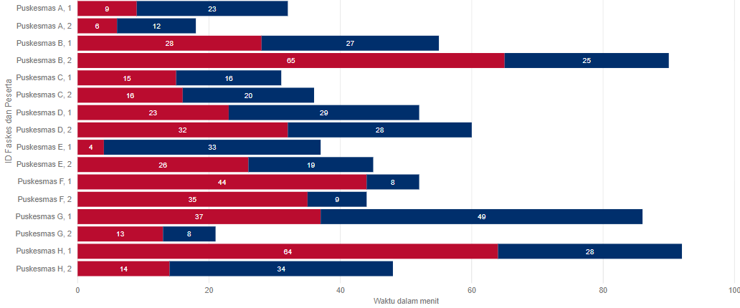
Client Flow mapping results:
Time spent in waiting rooms / total time spent at facility by ART refill clients (n=18)
Of those observed, clients spent an average of 53% of their time waiting versus receiving care.

Slide 15
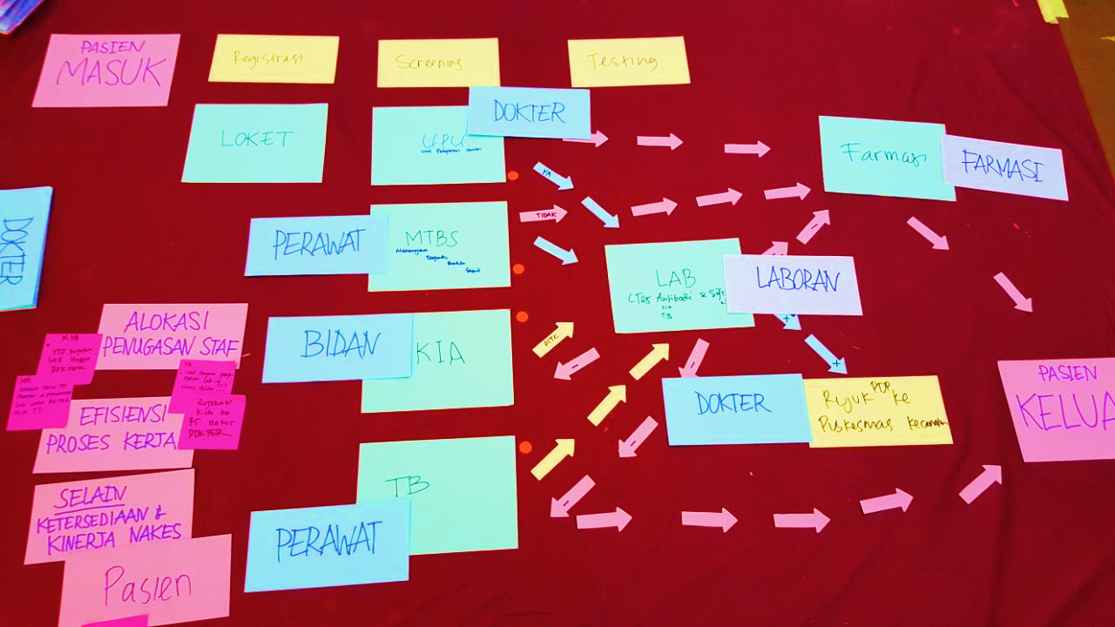
Health worker FGDs: Challenge identification
Health worker competency gaps
PKM management planning and budgeting for staff in-service training
Increase the number and capacity of Counselor
Low engagement
Stigma is not only felt by HIV client but also felt by the HIV core team
Puskesmas management's commitment to "see" that HIV services
are as important as other health service units
Poor allocation of staff or tasks
Additional task
Tasks distribution between health workers in the HIV team
Inefficient work processes
Manual recording system
SIHA
Integration of recording and reporting systems
Other health system issues
Almost all Puskesmas doesn’t have a special room for counseling
Some Puskesmas have the equipment for Viral Load test, but are constrained in procuring cartridges

Slide 16
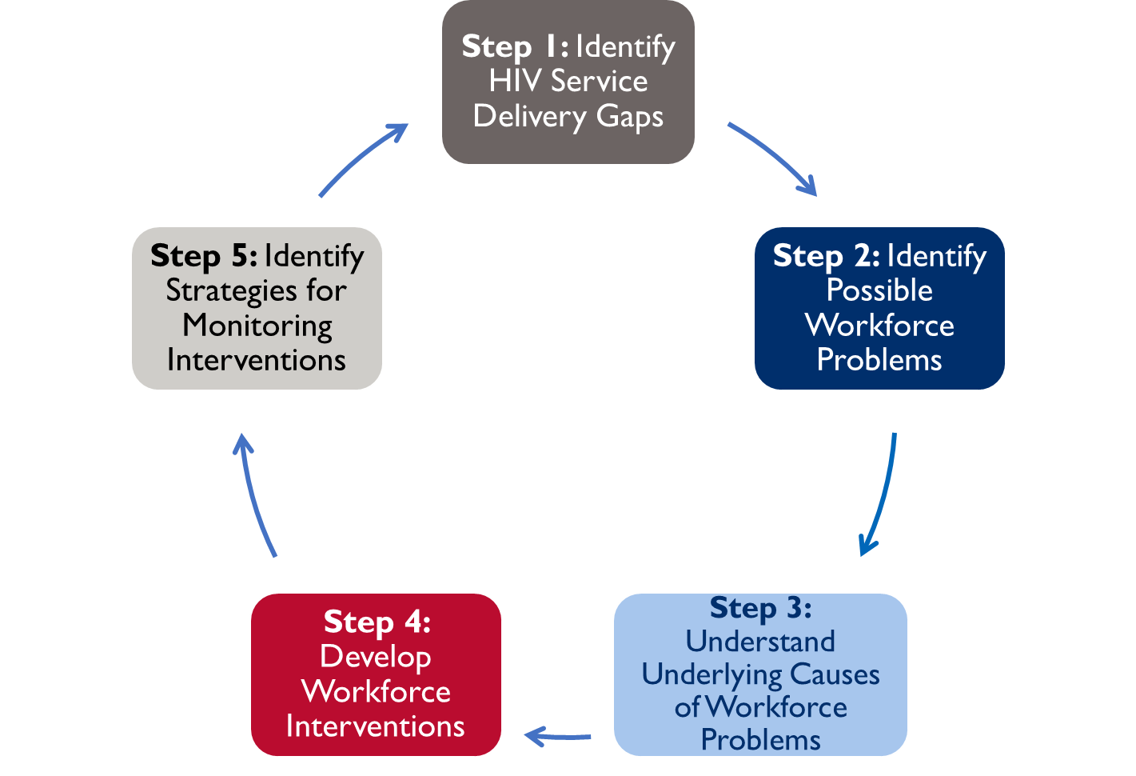
Optimizing Health Worker Performance and Productivity to Achieve 95-95-95 Targets
www.hrh2030program.org/prodperftoolkit

Slide 17
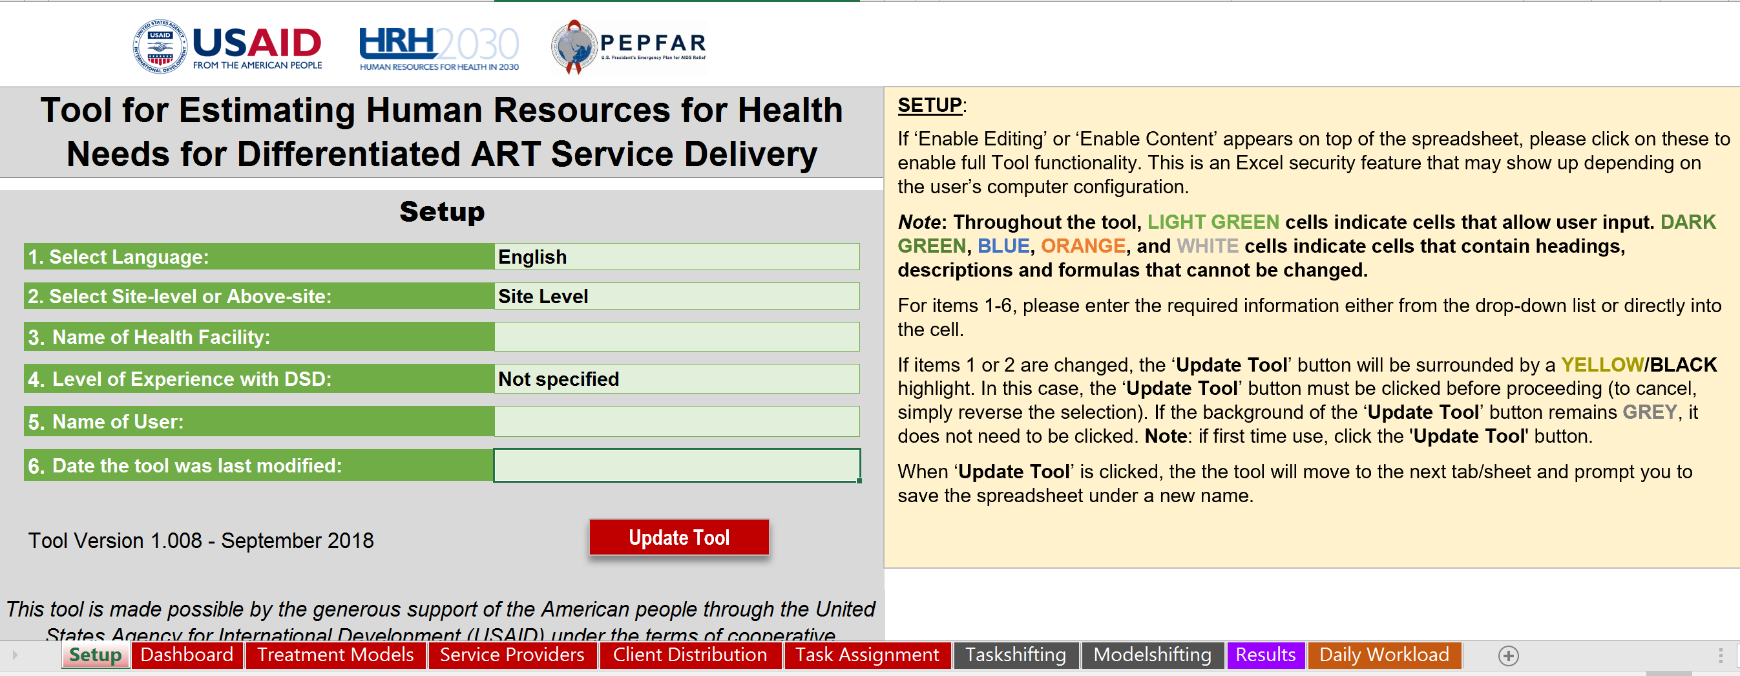
HRH Planning Tool: Task shifting and Different Service Models
https://hrh2030program.org/tool_hrh-planning-for-hiv/

Slide 18
Thank You

